Slide 1
IIntroduction to NoSQL
I N T R O D U C T I O N TO N O S Q L
Sagar Chhabriya

Slide 2
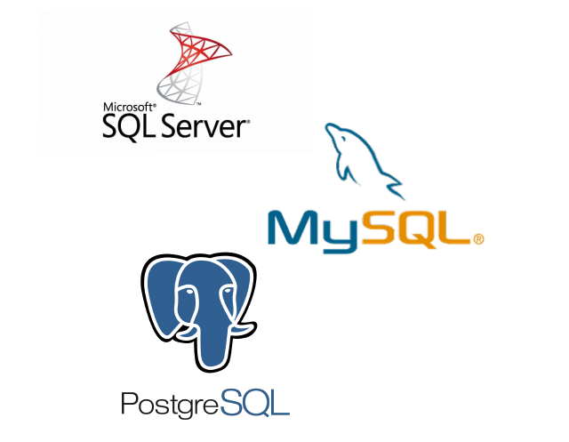
Traditional relational data stores (RDBMS)
Organize data in tables, using columns and rows
Leverage SQL to manage and manipulate data
Enforce integrity through constraints on databases and tables

Slide 3
What is NoSQL?
Definition: NoSQL stands for "not only SQL", and is a set of data storage tools and techniques that allows for structured, semi- structured, and unstructured data to be stored and retrieved.
Characteristics:
Allows for a wider range of data to be persisted and accessed
More flexible with regards to schema, captures data as it changes
Better scaling and performance
Provides a new challenge for data professionals

Slide 4
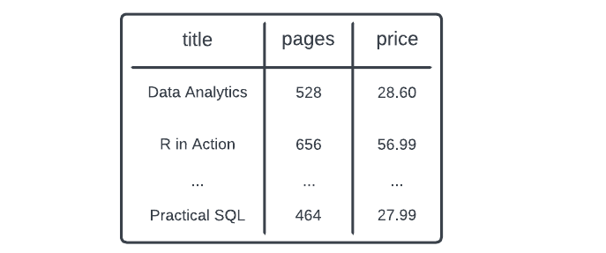
NoSQL data stores
Tabular
Non-tabular
{
"title": "Python for Data Analysis", "price": 53.99,
...
}
"weather": "sunny"
Semi-structured format More flexible schema
"Rectangular"
Using columns and rows

Slide 5


NoSQL data stores
Column-oriented
A NoSQL data store that stores data by column, rather than row, and can be queried with SQL-like syntax. Allows for faster querying of data, especially when running analytical queries.
Use case: large, analytics datasets
Document
A NoSQL data store that leverages a more flexible schema, made up of documents that can have their own structure. Documents are typically stored in JSON format.
Use case: user-generated data, such as reviews

Slide 6

More NoSQL data stores
Key-value
A NoSQL data storage tool that stores data as a collection of key-value pairs, and are best used with simple data that is written and read at a high frequency.
Use case: IoT (Internet of Things) data, mobile applications
Graph
A NoSQL data store that persists data in a network of nodes and edges. In graph databases, each node represents an entity, and each edge represents a relationship between those entities.
Use case: social networks

Slide 7
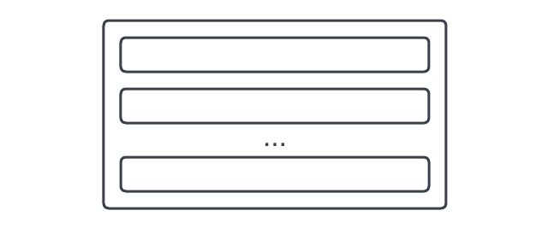

Tabular data stores
Column-oriented databases:
Store data in columns, rather than rows
Allow for selective column read and retrieval
Easier schema changes
Better data compression, query performance

Slide 8
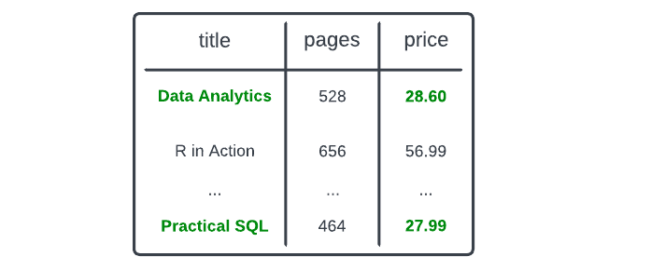
Querying a column-oriented database
SELECT
title, price
FROM books
WHERE price < 50.00;
SQL-like syntax
Column-elimination and selective reads/retrieval
Automatic data clustering

Slide 9
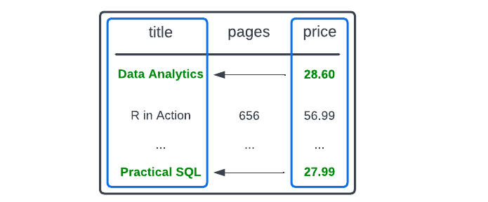
Query execution in column-oriented data stores
title, price
books
price < 50.00;
This query executes by:
Accessing price column, identify records with price < 50.00
Retrieving corresponding values from
title column
Later, we'll look at:
Optimizing data loads and deletes
Creating performant JOIN s Working with semi-structure data

Slide 10
Connecting to a Snowflake database
snowflake.connector
conn = snowflake.connector.connect( user="<user>", password="<password>", account="<account_identifier>", database="<database_name>", schema="<schema_name>", warehouse="<warehouse_name>"
)
The conn
variable will be created for you, pre-exercise

Slide 11
Writing and executing Snowflake queries
# Build a query in a string (or multi-line string) query = """
SELECT
title, price
FROM books
WHERE price < 50.00; """
# Execute the query, print the results
results = conn.cursor().execute(query).fetch_pandas_all() print(results)

Slide 12
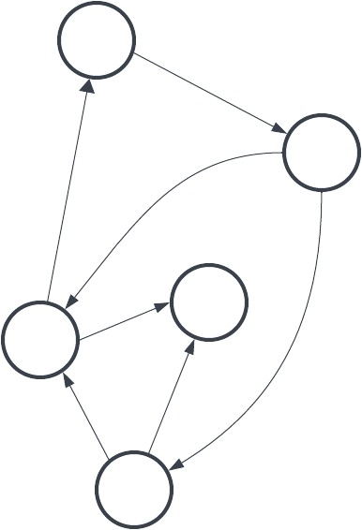
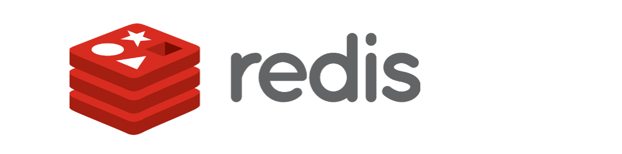
Non-tabular NoSQL data stores

Slide 13
Document databases
Definition: A NoSQL data storage tool that stores data in a flexible, semi-structured format, made up of key-value, key-array, and key-object pairs (similar to JSON).
{
"title": "Python for Data Analysis", "price": 53.99,
"topics": [
"Data Science", "Data Analytics",
...
],
"author": {
"first": "William"
...
}
}

Slide 14
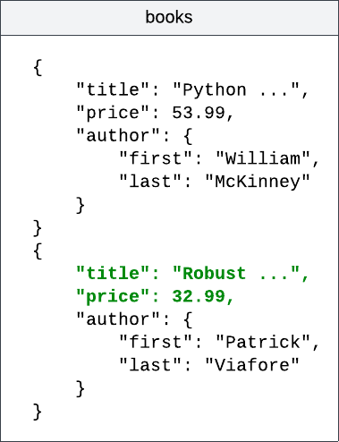
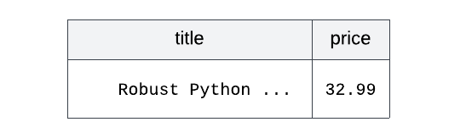
Querying JSON data with Postgres JSON
SELECT
books -> 'title' AS title, books -> 'price' AS price
FROM data_science_resources WHERE
books -> 'author' ->> 'last' = 'Viafore';
Resulting in the following output:

Slide 15
Connecting to a Postgres database
import sqlalchemy
# Create a connection string, and an engine
connection_string = "postgresql+psycopg2://<user>:<password>@<host>:<port>/<database>" db_engine = sqlalchemy.create_engine(connection_string)
To create a connection to a Postgres database: Form a connection string
Create an engine using sqlalchemy

Slide 16
Writing and executing Postgres JSON queries
To write and execute a query:
Build a query in a string
Pass query and db_engine to the
pd.read_sql() function
Print the resulting DataFrame
import pandas as pd
# Build the query query = """
SELECT
books -> 'title' AS title, books -> 'price' AS price
FROM data_science_resources;
"""
# Execute the query
result = pd.read_sql(query, db_engine) print(result)

Slide 17
Other non-tabular NoSQL data stores
Key-value
{
"name": "Jane Doe", "age": 25,
"email": "jdoe@datacamp.com"
}
Graph

Slide 18
Let's practice!
I N T R O D U C T I O N TO N O S Q L

